Slide 1

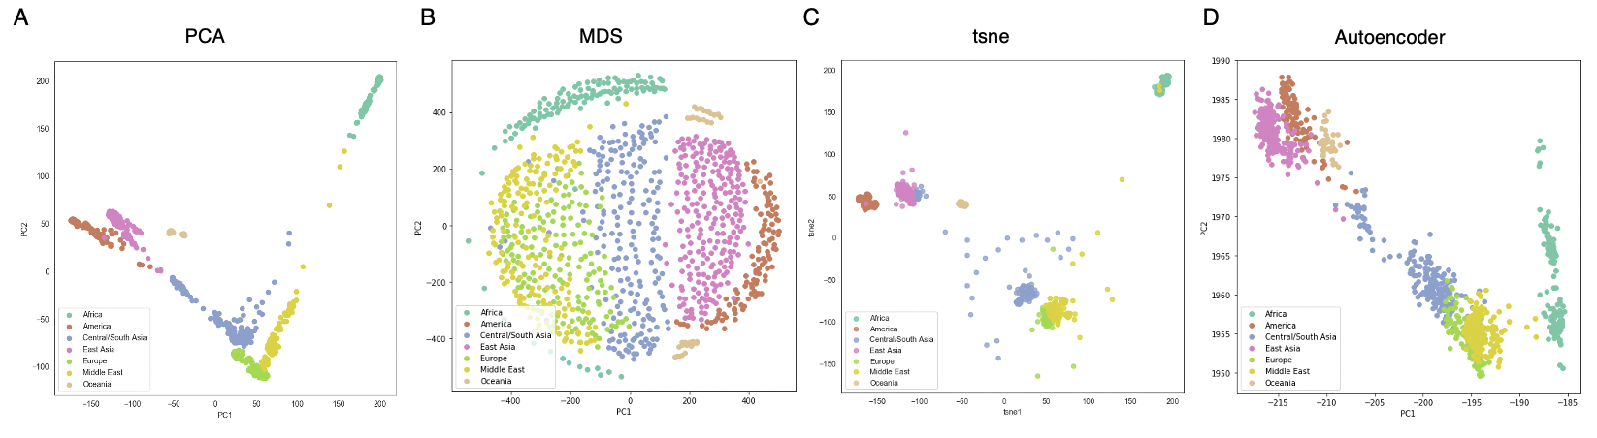
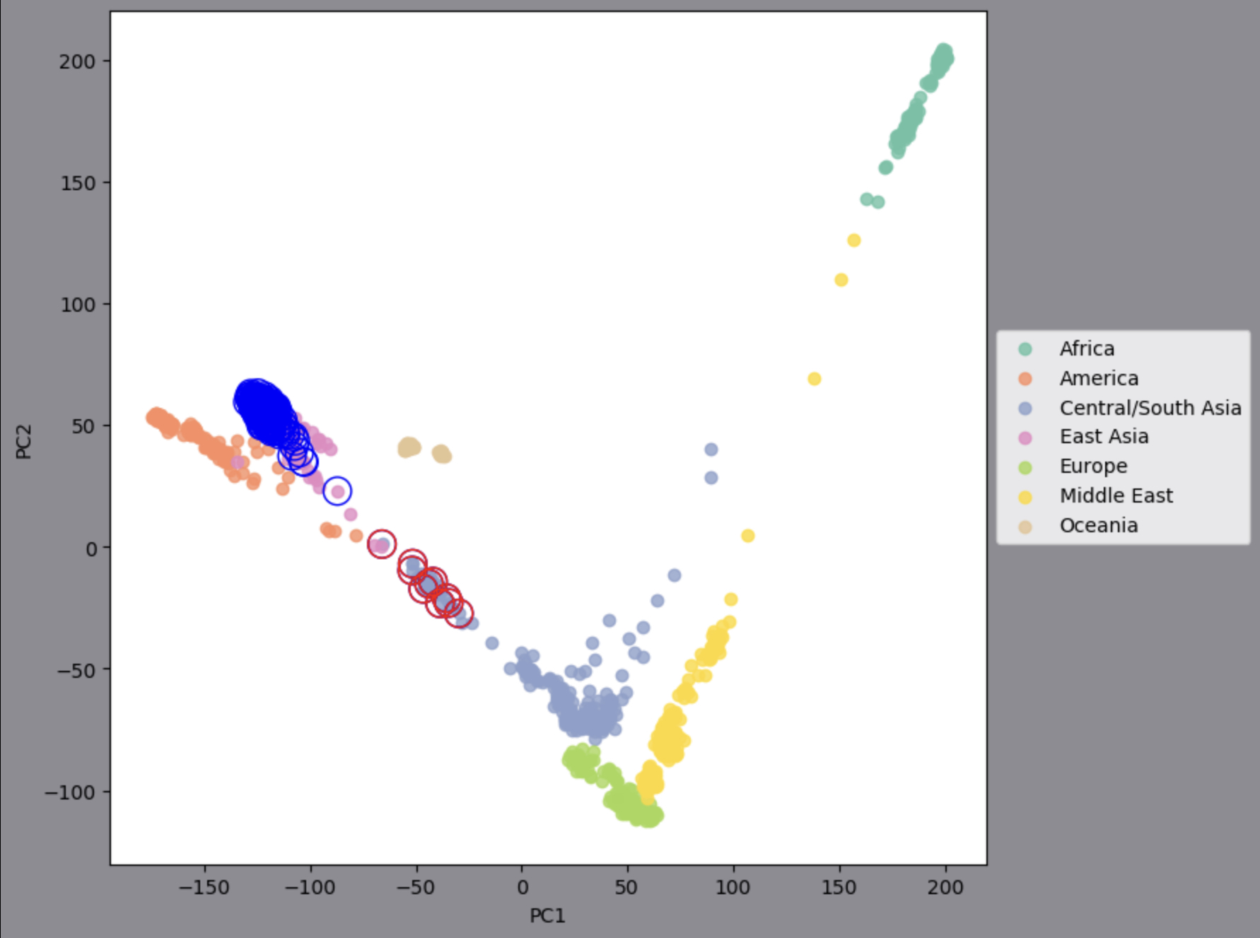
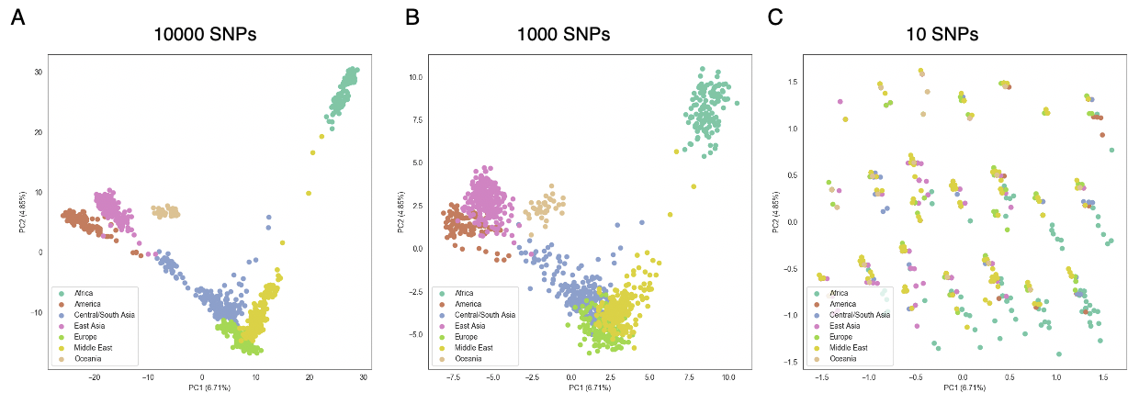
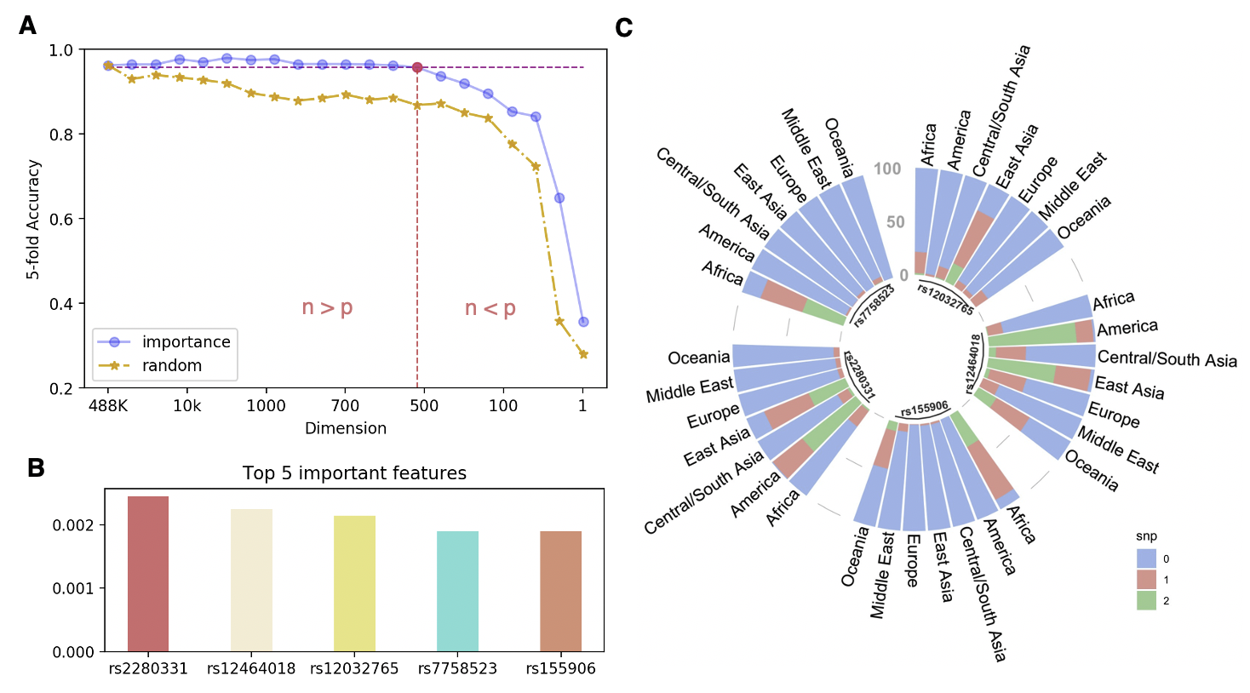
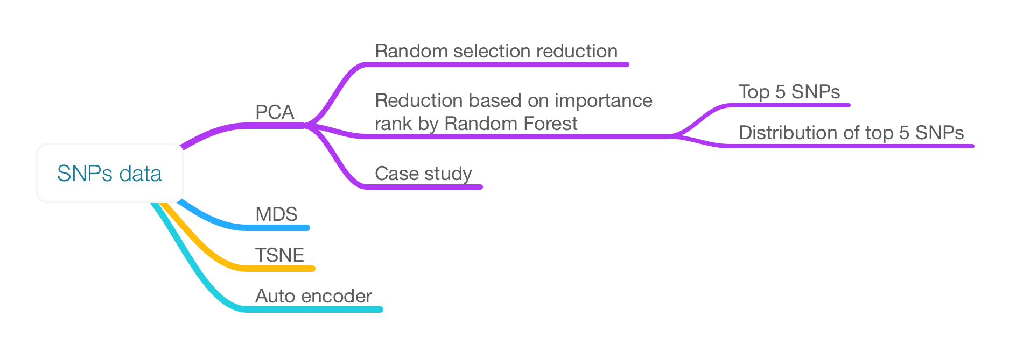
Deciphering Regional Variations Using SNPs
Yingxi Yang, Hanli Huang {yyangea,hhuangbj}@connect.ust.hk
Presented by
Wang Genomics Lab
Department of Bioengineering
Introduction
Results
Single-nucleotide polymorphisms (SNPs) is a substitution of a single nucleotide that occurs at a specific position in the genome, where each variation is present at a level of 0.5% from person to person in the population^{[1]}. SNPs data is usually highly dimensional, therefore it’s hard to directly dig out useful information for detail analysis. Principal component analysis (PCA) can reduce the dimension and keep most important information.
In this project, we applied PCA to investigate how could SNPs data inform the region that people come from. Result showed classical PCA can well separate 7 regions and when we reduced the SNPs number, it kept separation till only 512 important SNPs remaining. Case study further investigated the location of points on PCA result is related with real location of the population and interactions with other regions or populations.
Part1. Comparison of different methods
Part4. Case study
Separation results comparison of 4 different methods for SNPs data. Fig 1A, Classical PCA; Fig 1B, Multiple Dimensional Scaling; Fig 1C, TSNE after PCA; Fig 1D, Autoencoder^{[2]}. The result shows all 4 methods can separate 7 regions by SNPs data, while classical PCA got more intuitive shape.
Further analysis in Chinese cohort shows Uighur (red circles) population is separated from the main cluster of Chinese people (blue circles) and more closed to Central/South Asia, which is consistent with our knowledge that the habitation of Uighur is neighbored to Central Asia.
Part 2. PCA results with reduced number of SNPs
PCA results with randomly selected number of SNPs data. 10000, 1000 and 10 SNPs used in Fig 2A, Fig 2B and Fig 2C. Results of 10000 and 1000 SNPs are similar with Fig 1A. When the number of SNPs used in PCA reduced to 10, all 7 regions can no longer be separated.
Discussion
In this project, we explored how less SNPs used that can still separate regions of people. If we ranked the SNPs importance by Random Forest, the number of SNPs can be reduced to 512 and still kept the prediction accuracy and well separation. For random selection, the number was larger.
Further we analysed the distributions of top 5 important SNPs in 7 regions cohorts. Interestingly, each of them enriched in specific regions with different genotypes, what explained their importance rank in Random Forest selection. Case study shows more detail and interesting information could be dug out in the future analysis. The relationship between PCA result and other labels is also informative.
Dataset
In this project, we used SNPs data from
Quanhua Mu and Yoonhee Nam
( https://pan.baidu.com/s/1vDi0cLWl6GiWgm7icaZy-w ;
https://drive.google.com/file/d/11Q-8B57WDQnrIV92b-h_WLqDGviiYsm2/view?usp=sharing ). The data is a matrix with 488,890 rows of SNPs and 1043 columns of people.
Figure below shows our pipeline of this project. As SNPs data is very high dimensional, we used 4 methods to compare the dimension reduction results. Then we explored the impact of SNPs number reduction for the separation results. In the third part, we analysed the top 5 important SNPs. Finally, some case study was produced.
Part 3. Statistical analysis with machine learning
We used different number of SNPs features to predict the region of people and compared 5-fold accuracy to investigate the lower bond of SNPs number that can separate 7 regions. Fig 3A shows accuracy drop figure. The yellow line shows the accuracy drop with random selection. The blue line is the result that we reduced SNPs numbers based on feature importance. The result shows the most important 512 features can keep the original information.
Fig 3B shows top 5 most important SNPs in the result of Random Forest^{[3]}. Fig 3C shows distributions of top 5 SNPs in 7 regions. Only East Asia and America cohorts are enriched with 1(AC) and 2(CC) genotypes for rs2280331. Similarly, only Africa is enriched in 1 and 2 genotypes for rs7758523. These results explain why top 5 SNPs are most important for region separation.
References
1. 1000 Genomes Project Consortium. A global reference for human genetic variation[J]. Nature, 2015, 526(7571): 68-74.
2. Wang Y, Yao H, Zhao S. Auto-encoder based dimensionality reduction[J]. Neurocomputing, 2016, 184: 232-242.
3. Botta V, Louppe G, Geurts P, et al. Exploiting SNP correlations within random forest for genome-wide association studies[J]. PloS one, 2014, 9(4).
Contribution
Dimensionality reduction, machine learning → Yingxi YANG
Machine learning, case study → Hanli Huang

